Slide 1






The Longitudinal Employer-Household Dynamics (LEHD) Program and
Arizona’s Workforce
2024 Arizona State Data Center Annual Affiliate Meeting
Presented by: Earlene K.P. Dowell
October 17, 2024
US Census Bureau

Slide 2



Outline
LEHD Program and LED Partnership
Data Products and Tools and more
Q&A
LEHD.CES.Census.Gov
To review past LED Workshops and Webinars please visit the Workshop/Webinars tab for more information.
Find stories on how LEHD data is being used on our LED in Action tab.

Slide 3
LEHD Program and LED Partnership

Slide 4

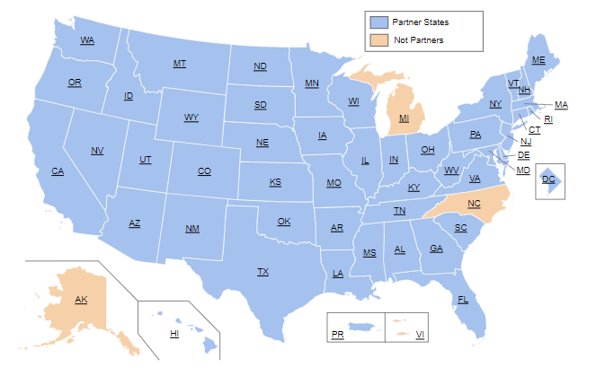
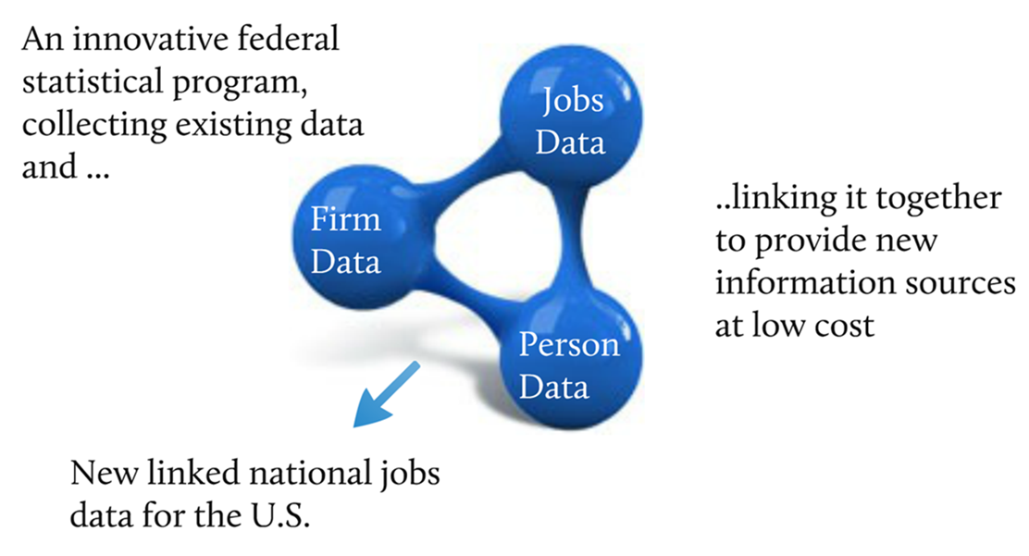
Program and Partnership
Notes:
Arizona joined the partnership in 2004

Slide 5

LEHD Data Products

Slide 6

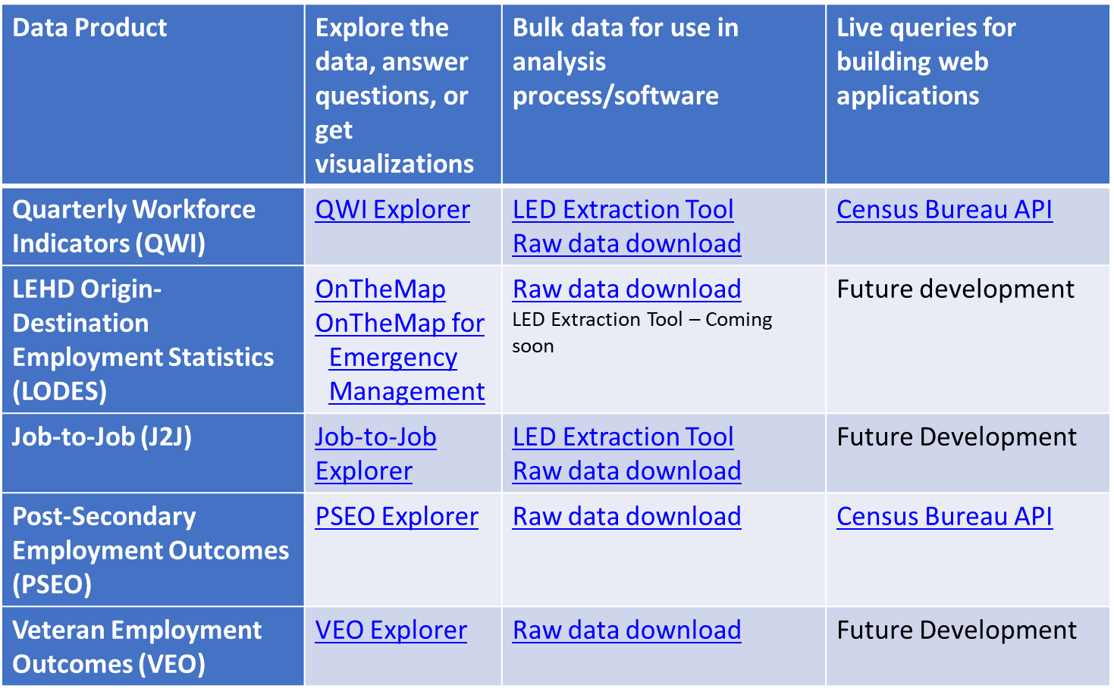
Longitudinal Employer-Household Dynamics (LEHD)
Notes:
J2J – raw data goes down to the 3-digit NAICS

Slide 7

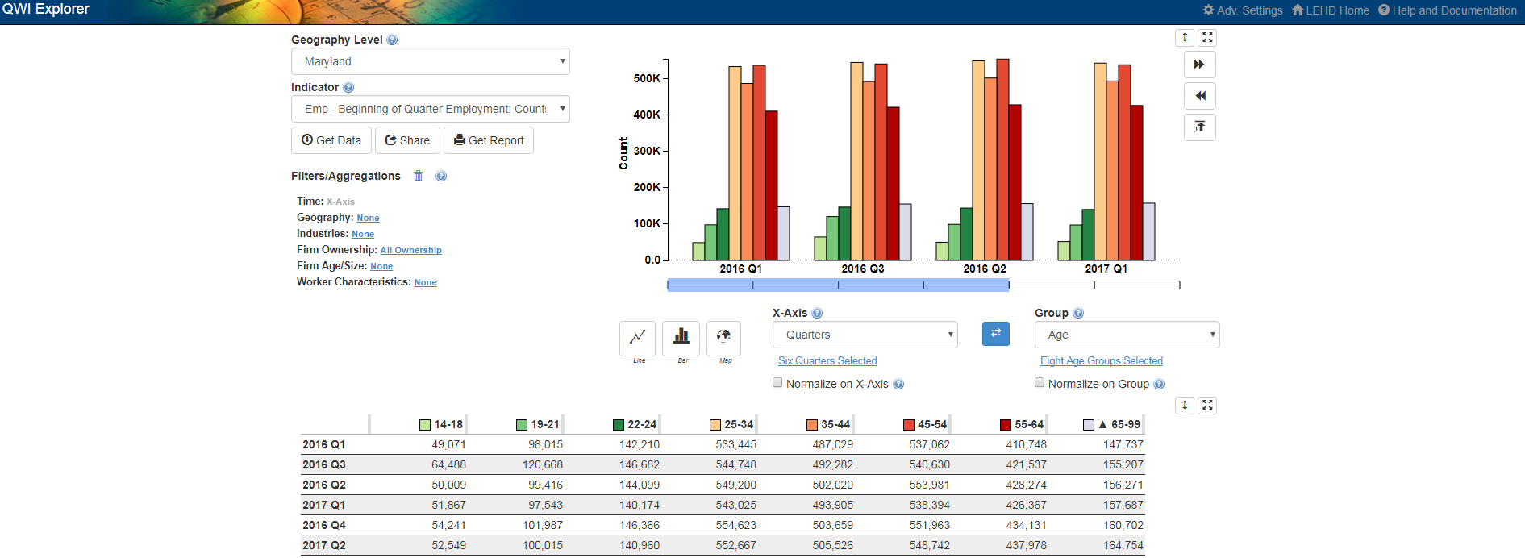
QWI Explorer
32 Quarterly Workforce Indicators
Flexible Pivot Table and Map/Chart interface
Data on detailed interactions between firms and workers include employment, employment change (individual and firm), and earnings
Analyze/report by worker demographics: age, earnings, race, ethnicity, educational attainment, and sex
Analyze/report by firm
characteristics: NAICS
classification (sector, 3, 4), firm
age, and firm size
Quarterly data very current
(9-12 months old)
National and 50 states available
(plus DC)

Slide 8
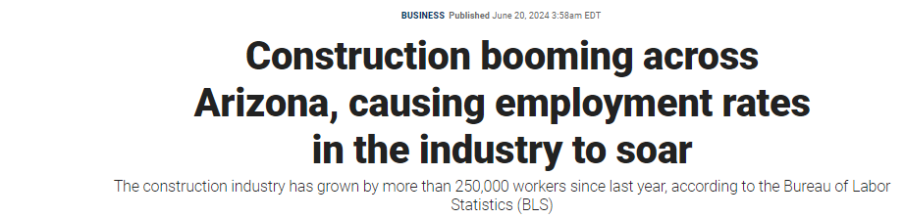
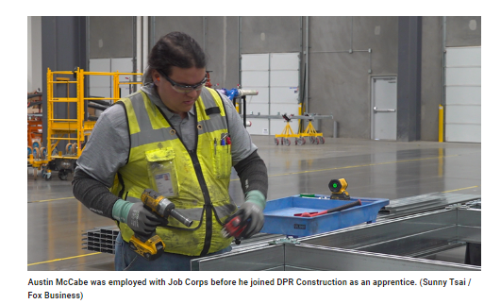

Slide 9
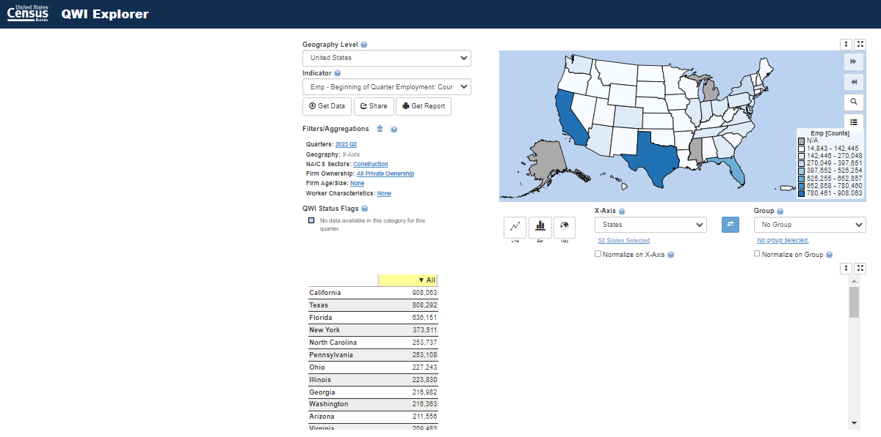
Arizona Ranks 11th in the U.S. in Construction
Notes:
https://www.foxbusiness.com/industrials/construction-booming-arizona-employment-rates-industry-soar
https://qwiexplorer.ces.census.gov/#x=0&g=0

Slide 10
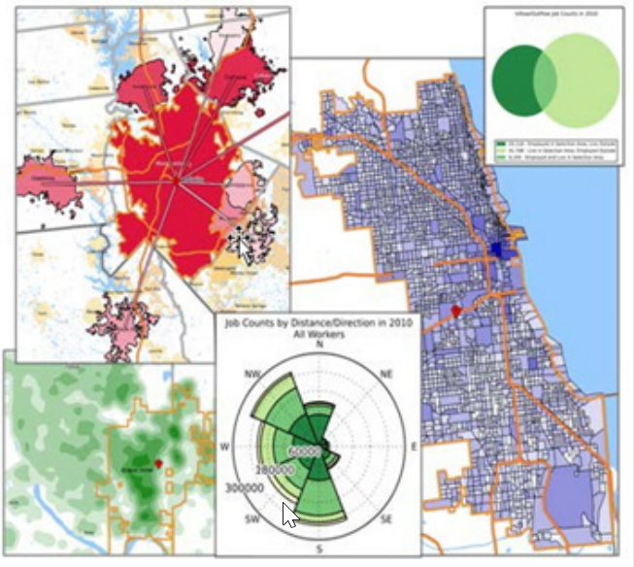
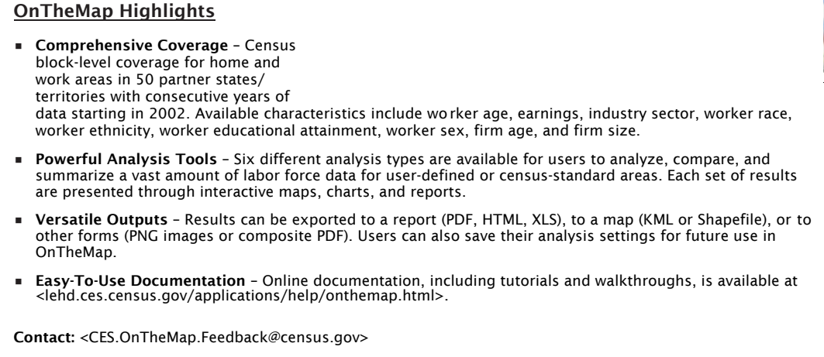
OnTheMap

Slide 11

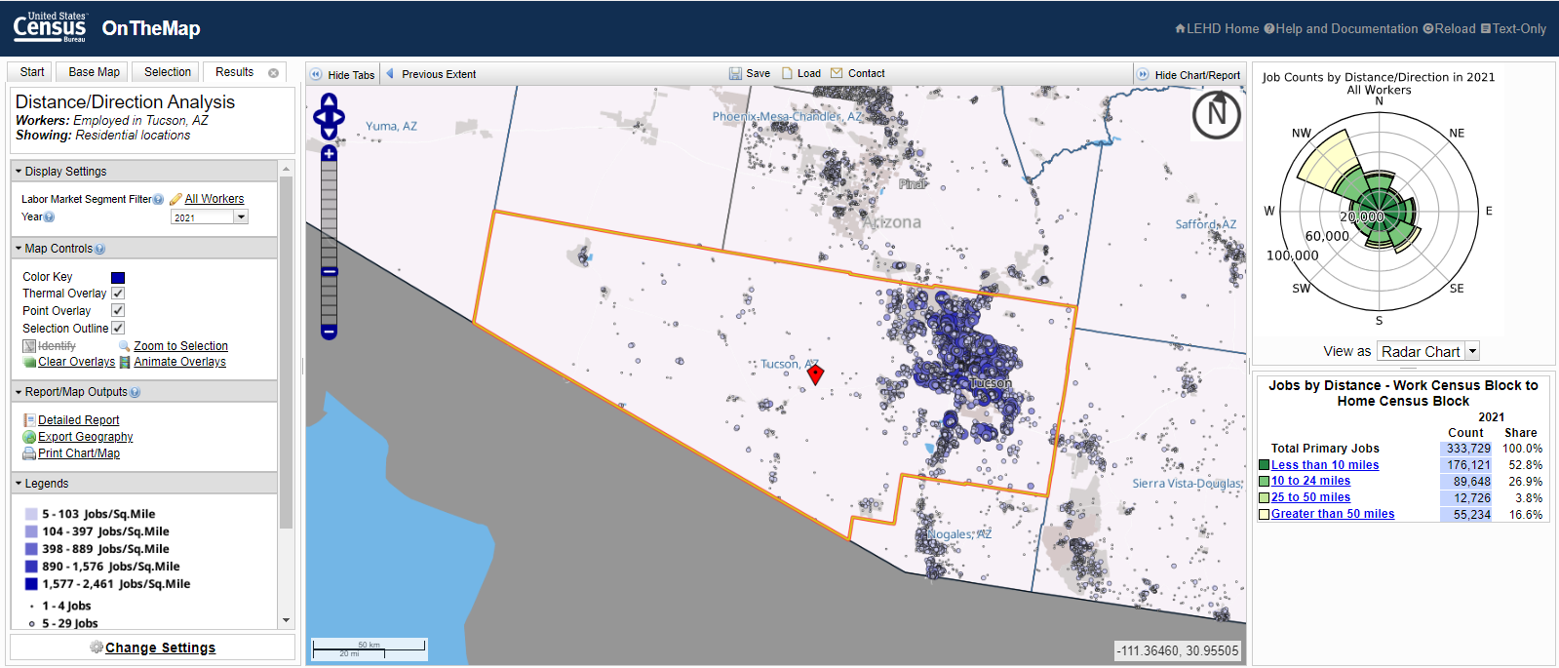
Tucson Has the 8th Best Commute in the U.S.
Notes:
https://www.foxbusiness.com/lifestyle/cities-offer-best-commutes-workers

Slide 12

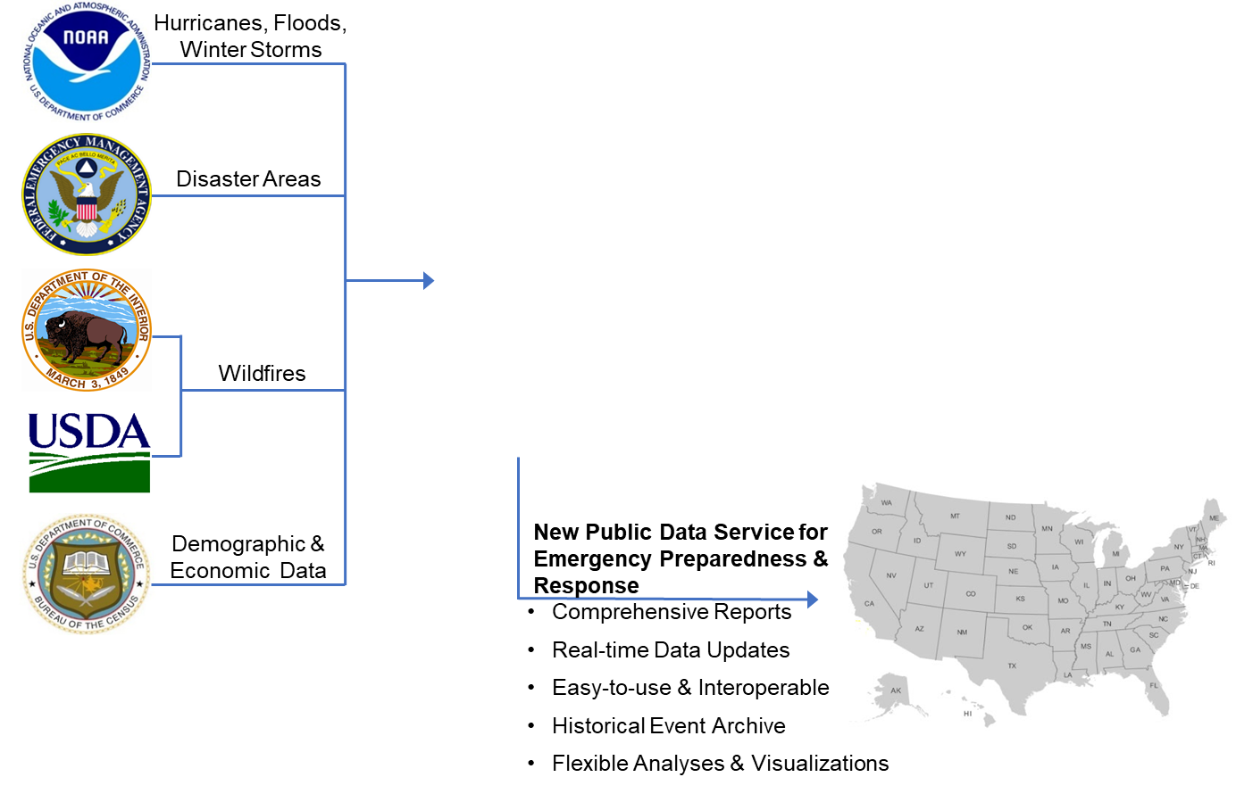
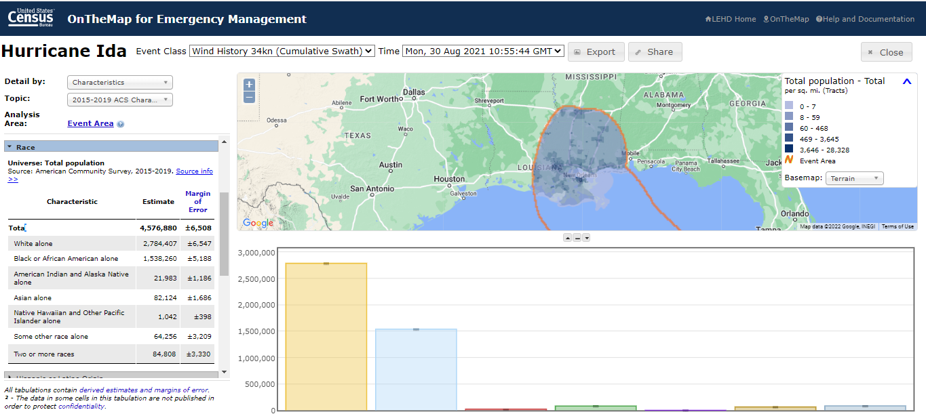
OnTheMap for Emergency Management

Slide 13
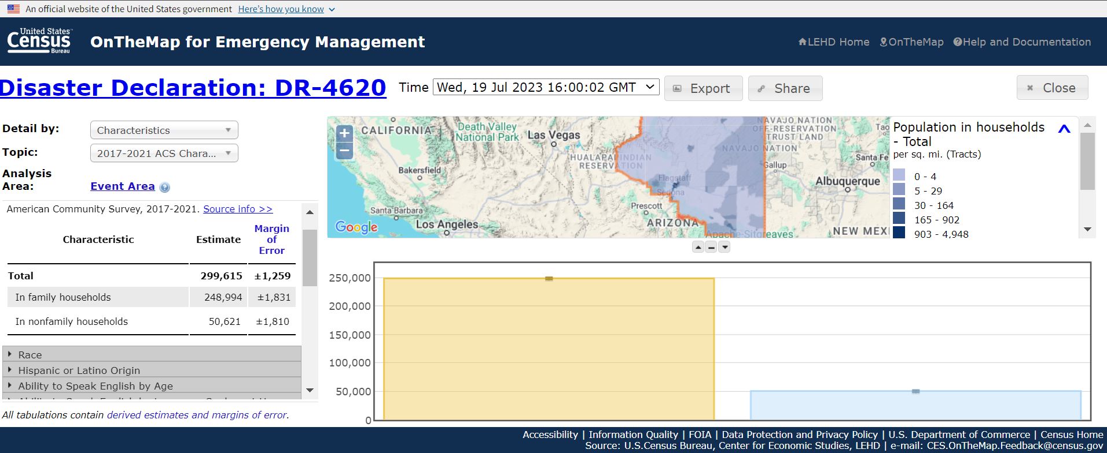
Arizona Severe Storms and Flooding

Slide 14
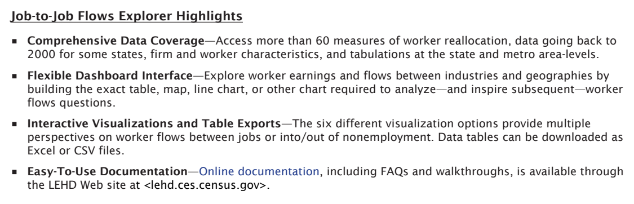
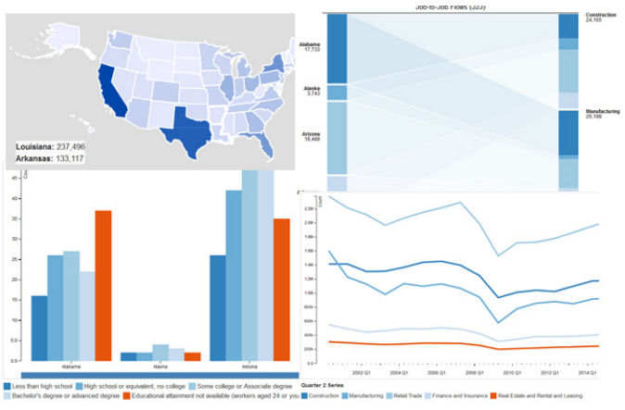
Job-to-Job Explorer

Slide 15
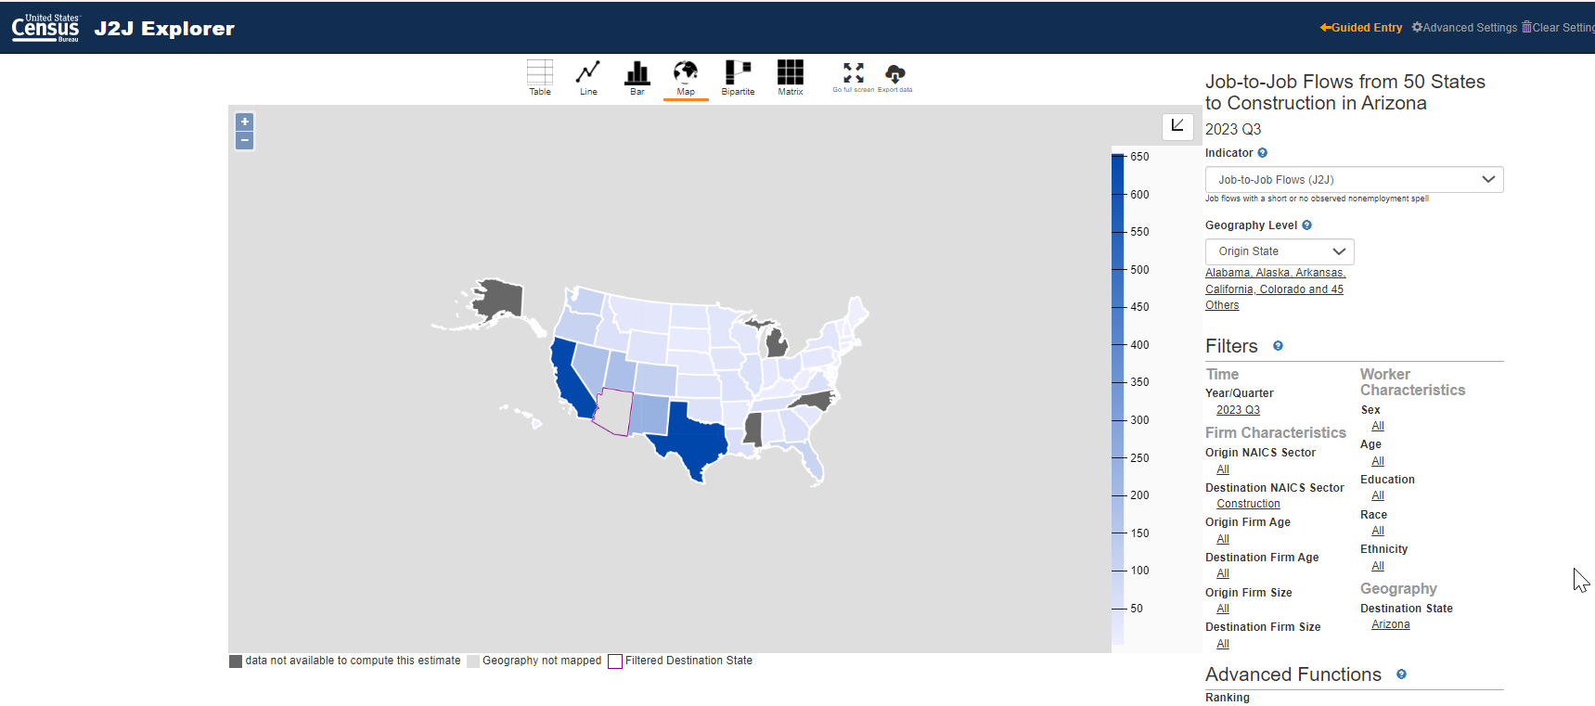
Hires to Construction in Arizona

Slide 16

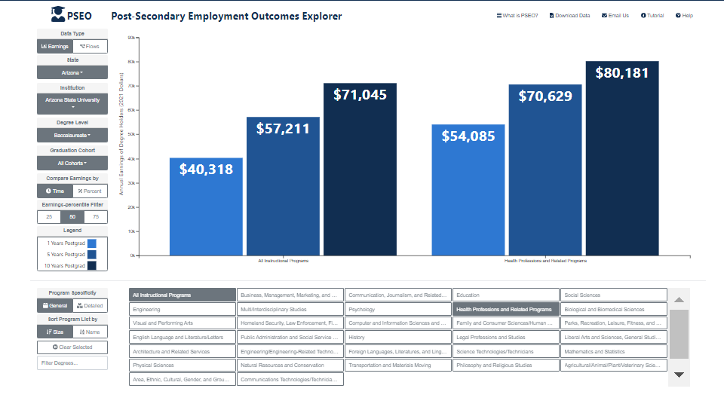
Post Secondary-Employment Outcomes and the College Connection

Slide 17
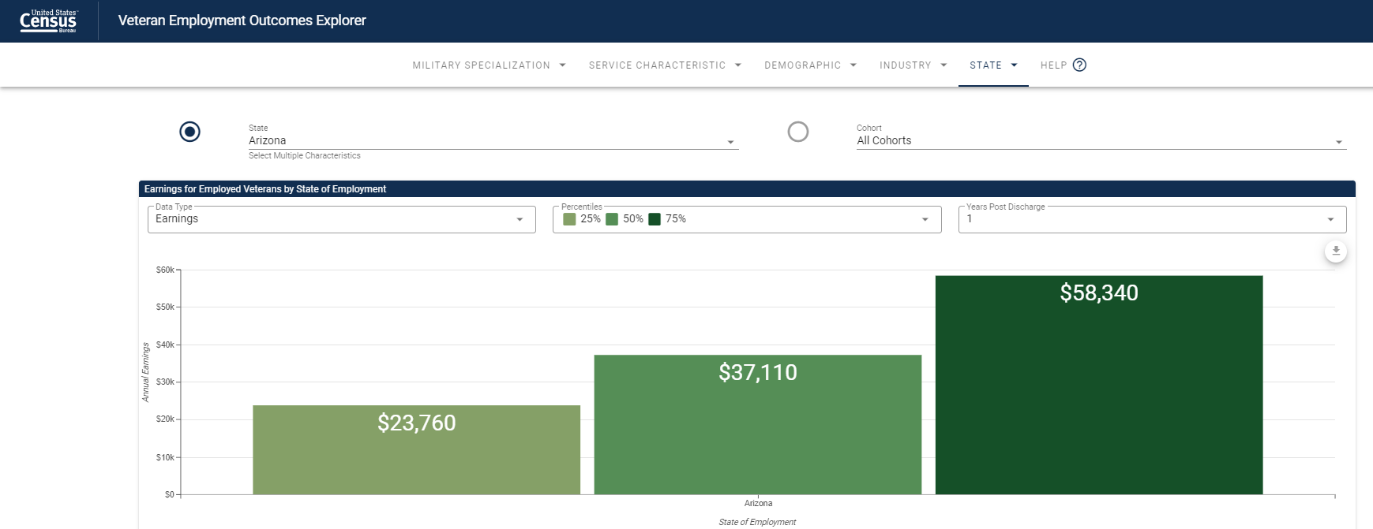
How Much Does a Veteran Make in Arizona?

Slide 18
Summary and Resources
Help and Documentation
  Quarterly Workforce Indicator
  lehd.ces.census.gov/applications/help/qwi_explorer.html
  Job-to-Job Flows
  lehd.ces.census.gov/applications/help/j2j_explorer.html
  OnTheMap
  lehd.ces.census.gov/applications/help/onthemap.html
  OnTheMap for Emergency Management
  lehd.ces.census.gov/applications/help/onthemap_em.html
  Post Secondary Employment Outcomes
  lehd.ces.census.gov/data/pseo_experimental.html
  Veteran Employment Outcomes
  lehd.ces.census.gov/data/veo_experimental.html

Slide 19

Q & A and Thank You!
Contact Information:
Earlene K.P. Dowell
Earlene.KP.Dowell@Census.Gov
For detailed questions concerning the 2020 Decennial, contact:
301-763-INFO or 800-923-8282
To schedule additional training with a Census Data Dissemination Specialist in your area, please call 844-ASK-DATA Or email us at: census.askdata@census.gov

